Slide 1
Practices of Civic Engagement

Slide 2
What is Civic Engagement?
Civic engagement is taking responsibility for improving your community.
It’s any activity that works to address a public concern.
It can be as simple as starting a conversation about local issues (in-person or on social media), or you can take some action.
You can work together to provide value and improve the quality of life for the public.

Slide 3
How do you engage with your community?
There are many ways to stay up to date with current events, like mobile news apps and podcasts.
There are also tons of ways to participate in your community and advocate for the causes you believe in.
You can contact local officials to voice your concerns. Or, you can vote in local, state, and national elections.
Many others prefer to volunteer around their communities.

Slide 4
Why practice civic engagement?
Improved relationships – Engaged community members develop stronger connections with one another
Increased social cohesion – Community members develop a sense of trust, belonging and reciprocity
Improved community – Engaged people actively work to improve their community and care for it through volunteering, education and other activities
Better education – Engaged citizens are more likely to read and discuss the news and share information with others
Greater understanding – The right civic engagement opportunities can help keep the community informed about local events and opportunities
Growth and development – Civic engagement can mean investing in community members with skills, information and motivation to contribute and make a difference
Individual responsibility – It encourages individuals to see themselves as part of a wider community and feel responsible for contributing to and improving that community for the benefit of all
Better quality of life – Community members can address their concerns and influence decisions to improve the quality of life for the community as a whole
Better government – Civic engagement is essential for a functioning democratic government

Slide 5
What is civic engagement used for?
Greater inclusiveness and diversity: Because so many people groups are underrepresented in government, their issues are often missed or ignored when it comes to policy making. Civic engagement can shine a light on these areas to promote greater inclusiveness and policy making that fixes this issue.
Youth engagement: Studies show that the numbers of politically engaged youth are dropping. Civic engagement activities might focus on empowering young people to participate and have a say in their community and government.
Improved education: Part of civic engagement is ensuring voters and community members are more informed so that the community can make better decisions as a whole. This might include topics like how the local political system works, how to enroll to vote and how to cast your vote in an upcoming election.
Informing policy: An engaged community will share their perspectives and opinions and shape policy development. This ensures people at government level better understand the experience of community members.

Slide 6
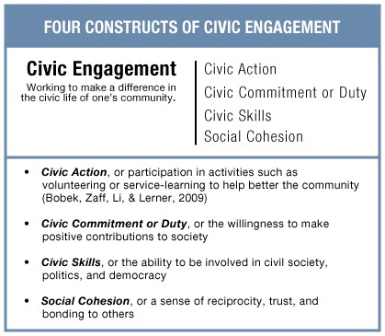
Four Construct of Civic Engagement
Civic action (community volunteerism)
Civic skills (recruitment of new members & retention)
Social cohesion (Cultural awareness, diversity and inclusion programing)
Civic commitment (community improvement participation, and even voting)

Slide 7
Categories of Civic Engagement
Civic
Electoral
Political Voice

Slide 8
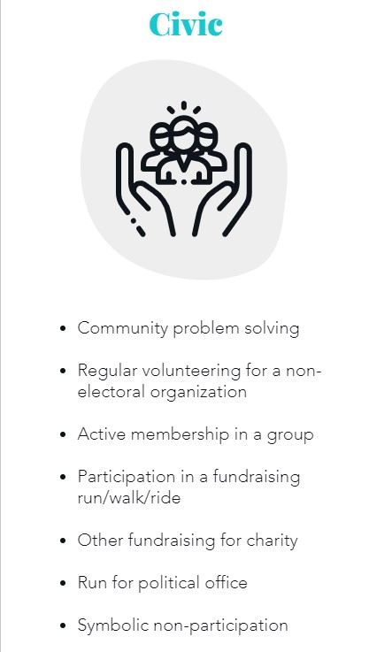
Categories of Civic Engagement – Political Voice

Slide 9
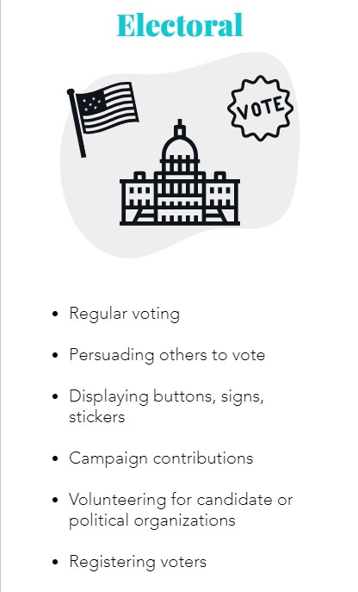
Categories of Civic Engagement – Political Voice

Slide 10
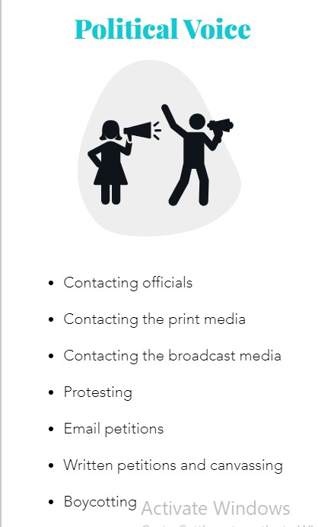
Categories of Civic Engagement – Political Voice

Slide 11
Practical Steps Relating Civic Engagement
Self-Awareness:
Reflect on Your Values: Understand your own beliefs, values, and priorities. Consider how these shape your views on civic issues.
Identify Your Passions: Recognize the causes and issues that resonate with you the most. This will guide your civic engagement efforts.
Assess Your Strengths: Recognize your skills, talents, and resources that you can contribute to civic causes.
Identity and Inclusivity:
Explore Your Identity: Understand your own identity in terms of race, gender, ethnicity, sexual orientation, and other aspects. Recognize how these factors influence your perspective.
Cultivate Empathy: Try to understand the experiences and perspectives of people from diverse backgrounds.
Promote Inclusivity: Advocate for inclusivity and diversity in your community, workplace, and social circles.

Slide 12
Practical Steps Relating Civic Engagement
Relationship Building:
Connect with Your Community: Build relationships with neighbors, local organizations, and community leaders to better understand local issues.
Network with Like-Minded Individuals: Join civic groups, clubs, or organizations that share your interests and goals.
Collaborate: Seek opportunities to work with others on civic projects or initiatives. Collaboration can amplify your impact.
Reflection and Learning:
Regularly Reflect: Set aside time for self-reflection on your civic engagement efforts. Consider what's working and what can be improved.
Learn Continuously: Stay informed about evolving issues, policies, and best practices related to civic engagement.
Seek Feedback: Ask for feedback from peers and mentors to grow and refine your approach.
Civic Education:
Educate Yourself: Study the history and functioning of your government, as well as the broader societal issues that affect your community.
Promote Civic Education: Support programs and initiatives that promote civic education, especially among youth.

Slide 13
Practical Steps Relating Civic Engagement
Practice Active Listening:
Listen Actively: When engaging with others, whether in discussions or community meetings, practice active listening to understand their perspectives fully.
Respect Diverse Opinions: Respect differing viewpoints, even if you disagree, and seek common ground for constructive dialogue.
Mentorship and Guidance:
Seek Mentorship: Find mentors or role models who have experience in civic engagement and can provide guidance.
Mentor Others: Share your knowledge and experiences with individuals who are new to civic engagement.

Slide 14
Practical Steps Relating Civic Engagement
Engage in Deliberative Dialogue:
Participate in Dialogues: Attend or organize forums for open and respectful discussions on important civic issues.
Practice Civil Discourse: Encourage civil and respectful communication, even when discussing divisive topics.
Evaluate Your Impact:
Assess Your Contributions: Periodically evaluate the effectiveness of your civic engagement efforts and consider adjustments.
Measure Outcomes: When possible, measure the impact of your actions on your community or cause.
Take Care of Your Well-Being:
Self-Care: Ensure you have the physical and emotional well-being to sustain your civic engagement efforts over time.
Avoid Burnout: Recognize when you need to take breaks or adjust your level of involvement to prevent burnout.

